Slide 1
THE OSI REFERENCE MODEL

Slide 2
OSI
Any data transmitted from any source passes through seven different steps to reach the destination. The sum of these seven steps is called OSI reference model

Slide 3
OSI
A LAYERED APPROACH
APLICATION LAYER
PRESENTATION LAYER
SESSION LAYER
TRANSPORT LAYER
NETWORK LAYER
DATA LINK LAYER
PHYSICAL LAYER

Slide 4
APPLICATION LAYER
Provides an interface between the end user and computer application
Preparation of new data item, editing and updating etc.
Not Network oriented applications and network oriented applications
Allows application to use network
Handles flow control, error control, error recovery etc

Slide 5
APPLICATION LAYER
PROTOCOLS
    SNMP
    FTP
    TFTP
    SMTP
    HTTP
    TELNET
DEVICES
    gateways

Slide 6
PRESENTATION LAYER
Converts data in the network understandable format
ASCII
ABCIDIC
Provides Data encryption
Provides Data Compression
Receives from application and transfers to the session layer

Slide 7
PRESENTATION LAYER
PROTOCOLS
    SNMP
    FTP
    TFTP
    SMTP
    HTTP
    TELNET
DEVICES
    gateways

Slide 8
SESSION LAYER
Responsible for opening, closing and maintaining the connection between the source and receiver applications
Simplex, Half Duplex, Full Duplex
Provides the synchronization between source an receiver
Offers the check points in the transmission , that is, if transmission fails, only the data after the check point must be transmitted again
Handles Remote Procedural Calls(RPCs)

Slide 9
SESSION LAYER
PROTOCOLS
    SNMP
    FTP
    TFTP
    SMTP
    HTTP
    TELNET
    RPC
DEVICES
    gateways

Slide 10
TRANSPORT LAYER
Transport of data across the nodes
Performs chunking(fragments) and reassembling
Provides sequence numbers for each fragment without loss and duplication
Connection oriented transmission (TCP/SPX)
Provides acknowledgement of correctly received data
Connection less transmission (UDP), does not guarantee the successful receipt

Slide 11
TRANSPORT LAYER
PROTOCOLS
    TCP
    UDP
    SPX
    NETBEUI
DEVICES
    gateways

Slide 12
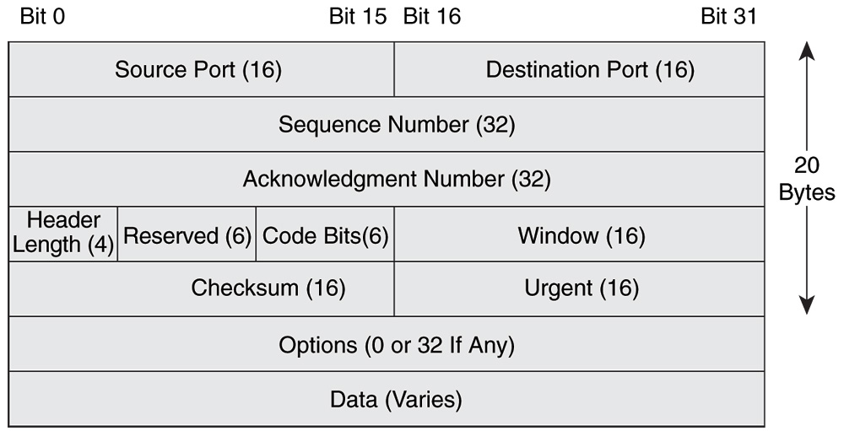

Slide 13
NETWORK LAYER
Performs Routing
    Determining the best possible Route(path) between sender and receiver
Logical addressing
    Software addresses to hard ware addresses are resolved
ARP, RARP
Information to correct address
Host group message reporting (IGMP)
Flow control ( ICMP)
Routing vs Routed Protocols

Slide 14
NETWORK LAYER
PR OTOCOLS
        IP
        IPX
        RIP
        OSPF
        IGRP
        EIGRP
        ARP
        RARP
        ICMP
        IGMP
DEVICES
    ROUTERS
    LAYER 3 SWICHES

Slide 15
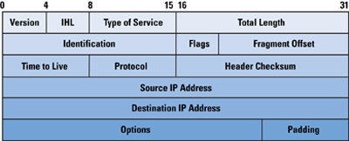

Slide 16
DATA LINK LAYER
Controls access to the communication channel
Frames are sent between layers
Further divided into two sub layers
Logical Link Control
    Establishes and maintains the link between the different devices on the network
Media Access Control (MAC)
    Deals with the fact that how devices share the common channel

Slide 17
DATA LINK LAYER
PROTOCOLS
    HDLC
    LLC
    PPP
DEVICES
    BRIDGES
    SWITCHES
    BROUTERS

Slide 18
PHYSICAL LAYER
Data conversion according to the media available
Specifies how signals are transmitted over the media

Slide 19
DATA LINK LAYER
DEVICES
    HUBS
    REPEATERS
    AMPLIFIERS
    TRANSCIEVERS
    MULTIPLEXERS
    RECIEVERS
    TRANSMITTERS
    CONNECTORS
    CABLES
    SWITCHES

